Slide 1
The Swedish approach to responsible fiscal policy
Lars Calmfors
Fiscal Policy for the Future seminar
The Treasury, New Zealand
18 March 2025

Slide 2
Structure of speech
Fiscal developments in Sweden
The national fiscal framework
EU fiscal rules
The current Swedish discussion
The stabilisation policy role of fiscal policy and the relationship to monetary policy
The Fiscal Policy Council

Slide 3
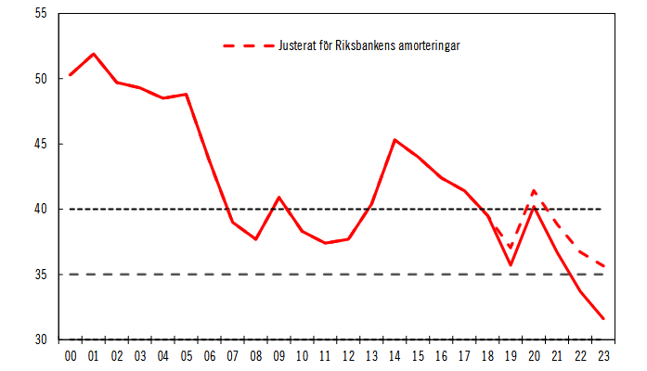
General government consolidated gross debt (Maastricht debt), per cent of GDP

Slide 4
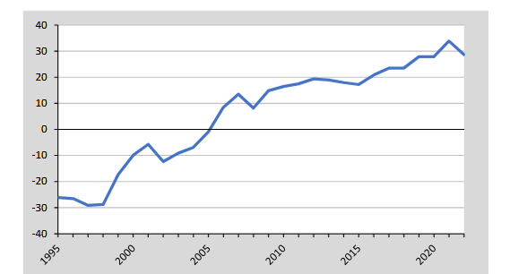
General government net financial wealth, per cent of GDP

Slide 5
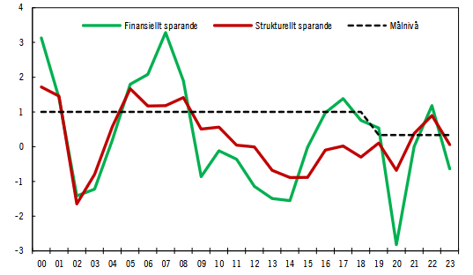
Government net lending, per cent of GDP

Slide 6
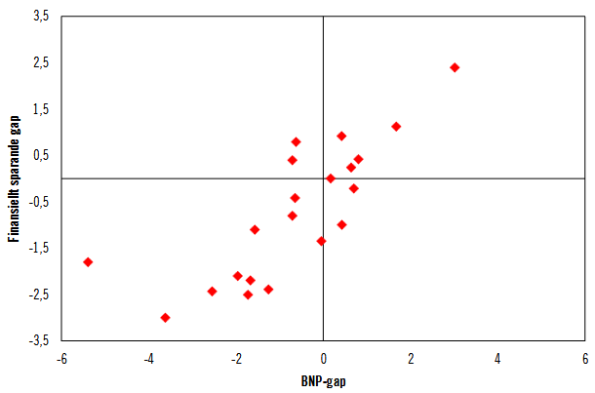
GDP gap and difference between government net lending and the fiscal target, per cent of GDP

Slide 7
Sweden’s fiscal framework
Top-down budget process for government and in parliament
- First stage: Overall decisions on taxes and expenditure areas
- Second stage: Decisions on individual expenditure items
Surplus target for general government net lending
- 1 per cent of GDP until 2018
- 0.33 per cent of GDP from 2019
Expenditure ceiling for central government
- Less binding over time
Balanced-budget requirements for local governments
- Regions
- Municipalities

Slide 8
Sweden’s fiscal framework cont.
Autonomous pension system but included in general government finances
- Defined benefits
Fiscal Policy Council established in 2007
- Ex-post monitoring of fiscal policy
Anchor for general government consolidated gross debt from 2019
- 35 per cent of GDP
- Because EU rules apply to this debt concept
- Worry that governmnet assets cannot be sold in a crisis

Slide 9
The impact of fiscal rules
Positive correlation between fiscal rules and fiscal outcomes
Question about causality
- Do rules cause fiscal outcomes?
- Do the same factors explain outcomes and rules?
Heinemann et al. (2018) meta analysis
- Weak support for causal link in studies with good methods to
handle endogeniety
- More support in more recent studies
Some support that IFIs improve fiscal outcomes
- But not so sophisticated methods to handle endogeneity

Slide 10
EU fiscal rules
As an EU member state Sweden is encompassed by the stability pact
Main rules:
- Deficit ceiling: 3 per cent of GDP (corrective arm)
- Debt ceiling: 60 per cent of GDP (corrective arm)
- Earlier medium-term objective for structural net lending: -1 per
cent of GDP
The EU rules have not been binding for Sweden
- More ambitious national targets
- But important aim to have precautionary distance to the EU
ceilings/objectives

Slide 11
Maastricht debt, 2024, per cent of GDP
Greece | 154
Italy | 139
France | 112
Spain | 106
Belgium | 105
Portugal | 96
Finland | 81
Germany | 63
Sweden | 33

Slide 12
2024 reform of the stability pact
Deficit and debt ceilings remain
The medium-term fiscal objective has disappeared
Fiscal-structural plans
Focus on growth of structural primary net expenditure
- Change in cyclically adjusted primary expenditure net of
discretionary tax changes
- Basically the change in the structural primary balance
Net expenditures should follow a path that reduces government debt if above 60 per cent of GDP or keeps it below this ceiling
New reporting obligations for Sweden to the EU, but the new rules are not likely to make much difference for us

Slide 13
Recent Swedish discussion on the fiscal framework
Discussion on lowering of the fiscal target
Need for temporary government expenditure increases, primarily investments
- Energy systems, including new nuclear plants, to promote the
green transition
- Transport infrastructure
- Water and sewage systems
- Defence equipment
- Aid to Ukraine

Slide 14
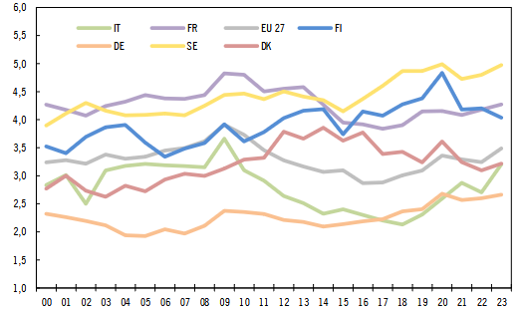
Government investment, per cent of GDP

Slide 15
Long-run net financial wealth and Maastricht debt at different levels of net lending, per cent of GDP
Net lending | Net financial wealth | Maastricht debt
0.33 | 33.1 | 28.4
0 | 24.1 | 37.4
-0.5 | 10.4 | 51.1
-1 | -3.2 | 64.2

Slide 16
How much should we borrow?
Safety margins if we are exposed to a deep economic crisis implying a large debt increase?
Intergenerational distribution of welfare under normal conditions (no debt crisis)

Slide 17
The risk of spiralling government debt because of snowball effects
Assumption of increase of government debt ratio by 50 percentage points in a crisis
Conservative assumption of maximum primary fiscal surplus of 2 per cent of GDP
Still possible to stabilise the debt ratio despite assumption that higher debt implies higher interest rates
Debt limit where government debt spirals out of control because of snowball effects is not reached

Slide 18
Effects of 0.5 per cent of GDP deficit instead of 0.33 per cent of GDP surplus, per cent of GDP
Interest-growth differential | Short-run primary surplus | Short-run net capital income | Long-run net capital income | Long-run primary surplus
1 | -0.83 | 0 | -1.05 | +0.22
0 | -0.83 | 0 | 0 | 0
-1 | -0.83 | 0 | -0.61 | -0.22

Slide 19
Long-run net financial wealth and Maastricht debt at different levels of net lending, per cent of GDP
Net lending | Net financial wealth | Maastricht debt
0.33 | 33.1 | 28.4
0 | 24.1 | 37.4
-0.5 | 10.4 | 51.1
-1 | -3.2 | 64.2

Slide 20
Problems with adoption of a balance target
Not sufficient room for desirable public investments
Politicians are likely to start fiddling with the target
- Debt-financed extrabudgetary items
- Such investments likely not be exposed to standard cost-benefit analyses
- No natural limit to how far one can go
Proposal on debt-financed defence fund
- Despite the fact that increase in defence spending likely to be permanent
- But argument for some temporary debt-financing in view of recent large real-wage
falls
- Gradual phasing-in of reductions in other expenditures and of tax rises

Slide 21
GDP gap and difference between government net lending and the fiscal target, per cent of GDP

Slide 22
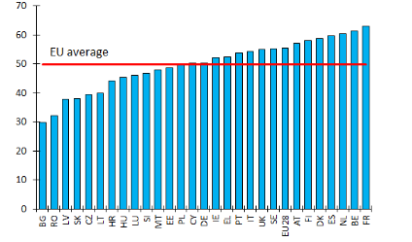
The strength of automatic stabilisers: The semi-elasticity of government net lending with respect to the GDP gap

Slide 23
Automatic stabilisers in Sweden
The budget semielasticity: the increase in government net lending as a share of GDP when the GDP gap increases by 1 percentage point
If tax revenues are proportional to GDP and government expenditure is independent of GDP, the budget semi-elasticity is approximated by the share of government expenditure in GDP
- Hence, one should expect a semi-elasticity around 0.5
Gradual fall in the semi-elasticity over time in Sweden
- 2000: 0.56
- 2022: 0.46
Two explanations:
- The share of tax revenues in GDP has fallen
- Less generous unemployment benefits
Conflict of goals
- Strong automatic stabilisers are desirable from a stabilisation policy point of view
- But earned income tax credits and less generous unemployment insurance strengthen incentives to work
- The size of automatic stabilisers is a by-product of other considerations than business cycle stabilisation

Slide 24
Automatic stabilisers in Sweden cont.
Automatic stabilisers in recessions are overestimated
- Balanced-budget requirement on local governments
- In a recession, they are forced to cut expenditure or increase
local tax rates
- Insufficient rainy-day funds
Suggested remedies:
- Cyclically dependent central government grants to local
governments
- Cyclically dependent unemployment insurance

Slide 25
Discretionary fiscal policy
Large international research literature on fiscal multipliers
- Higher multipliers than previously thought
- Especially when the interest rate reaches the ELB
Higher fiscal multipliers in Sweden than in most other countries
- Well above unity for public investment and public consumption

Slide 26
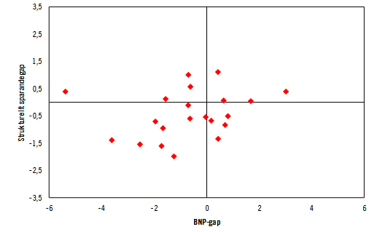
GDP gap and difference between structural government net lending and the fiscal target, per cent of GDP

Slide 27
Division of responsibility between fiscal and monetary policy
Guiding principle: Primary responsibility for stabilisation of inflation and output rests with the Riksbank
But lack of clarity on the exact relative roles of fiscal policy and monetary policy
Negative central bank interest rate 2015–20 because inflation tended to be below the 2 per cent target
QE before and during the pandemic

Slide 28
Consensus on problems with large central bank bond purchases
Large losses for the Riksbank
Hard to judge the effects of QE but probably smaller than of changes in the short-run interest rate
Shortening of the maturity of the debt of the consolidated government sector (including the central bank)
- Political decisions that should be taken by the government
Effects on the allocation of capital to various sectors and thus on resource allocation
- Also political decisions that should not be taken by the central
bank
New Riksbank act seeks to rein in the use of QE

Slide 29
The future role of fiscal policy
Consensus that it should play a larger role
But still no clear principles formulated
- Parliamentary commission on the fiscal target was quite vague
- Larger role when the interest rate reaches the ELB

Slide 30
My take
Rely on interest rate policy and the automatic fiscal stabilisers in
the case of normal cyclical swings
In other situations: fiscal policy should support monetary policy
Objective: avoid that monetary policy becomes extreme
- Avoid QE and negative interest rates in recessions
- Avoid excessively high interest rates in booms
- The Riksbank should be obliged to signal publicly when it sees a need for
support from fiscal policuy
Fiscal policy should not contradict monetary policy in situations with supply-side shocks
- Income insurance to low-income households
- Counteract long-term unemployment

Slide 31
Semi-automatic fiscal stabilisers
Active labour market programmes
- Training
- Subsidised jobs
Subsidised short-term work
Prepare in advance programmes of general tax rebates and transfers to low-income households
- Launch first after a discretionary decision

Slide 32
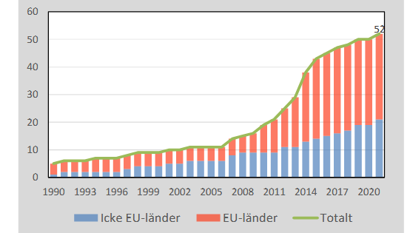
The number of independent fiscal institutions

Slide 33
The basic idea with IFIs
Monitor fiscal sustainability and adherence to fiscal rules
Increase the reputation cost of violating rules
Increase transparency of fiscal policy in general
Add more professional expertise to the economic-policy discussion

Slide 34
Examples of IFIs
Central Planning Bureau – Netherlands 1945
Economic Council – Denmark 1962
Congressional Budget Office, CBO – United States 1974
Fiscal Policy Council – Sweden 2007
- Monitor long-run sustainability of public finances and adherence
to the fiscal rules
- Evaluate stabilisation policy aspects of fiscal policy
- Evaluate employment and growth consequences of fiscal policy
- Stimulate the national economic-policy discussion in general
- Backward-looking focus: ex-post evaluations

Slide 35
Various aspects of the Fiscal Policy Council
Broad remit
- Helpful when recruiting members
The government is the principal
- The parliament is likely a better principal
A multi-annual budget would help safeguard independence
The original proposal from a government commission was on forward-looking (ex-ante) recommendations
- But the focus is now backward-looking (ex-post) evaluations

Slide 36
My take on the future of the Fiscal Policy Council
More focus on ex-ante recommendations
- Important role for stabilsation policy aspects
We are missing an arena for discussion about the interplay between monetary and fiscal policy
- The council could be such an arena
Worries of potential conflict between ex-ante recommendations and ex-post evaluations
- Proposal on separate independent Stabilisation Policy Council
- But we cannot have too many independent councils
- Small risks of conflict as long as communications are public

Slide 37
New EU rules on IFIs
Make, evaluate or approve the government’s macroeconomic forecasts
- Comply-or-explain basis
- More resources are needed: Today six members and secretariat
of only five persons
- Clearly insufficient already for costing of government proposals
Step in the direction of ex-ante recommendations
But further steps should be taken
- Activation of semi-automatic fiscal stabilsers?

